Slide 1

Modeling and Simulation in Python Course: Data 604 - Final Project Name: Sachid Deshmukh Date: 07/18/2020

Slide 2
State the problem and its significance.
Problem Statement: Simulate Covid-19 infections and deaths for the state of New York and analyse the effect of social distancing on final outcome (# infections and deaths)
This project uses an actual Covid-19 dataset for New York State. Following are the goals of the project.
Analyze open source Covid-19 data available for New York State
Devide data into two parts based on severity of social distancing followed (No Social Distancing vs Social Distancing)
Develop mathematical simulation to fit actual Covid-19 data for New York State (Use linear interpolation)
Identify Infection Rate and Death Rate between No Social Distancing period and Social Distancing period (Using mathematical model through simulation)
Perform "What If" analysis: The impact of social distancing on the final outcome (# of Infections and # of deaths)
This project answers a critical question: "How many lives could have been saved if we followed Social Distancing earlier in the state of New York during Covid-19 Pandemic"
Data is obtained from following open source github repo
Data Set Location: https://github.com/datasets/covid-19/tree/master/data
Note : Data is filtered and aggregated to reflect Covid-19 stats only for the state of New York. In the original git repo, there are two separate datasets for tracking infections and deaths. For the purpose of this project, data is already pre-processed by combining two separate datasets (infections and deaths) into one consolidated dataset

Slide 3
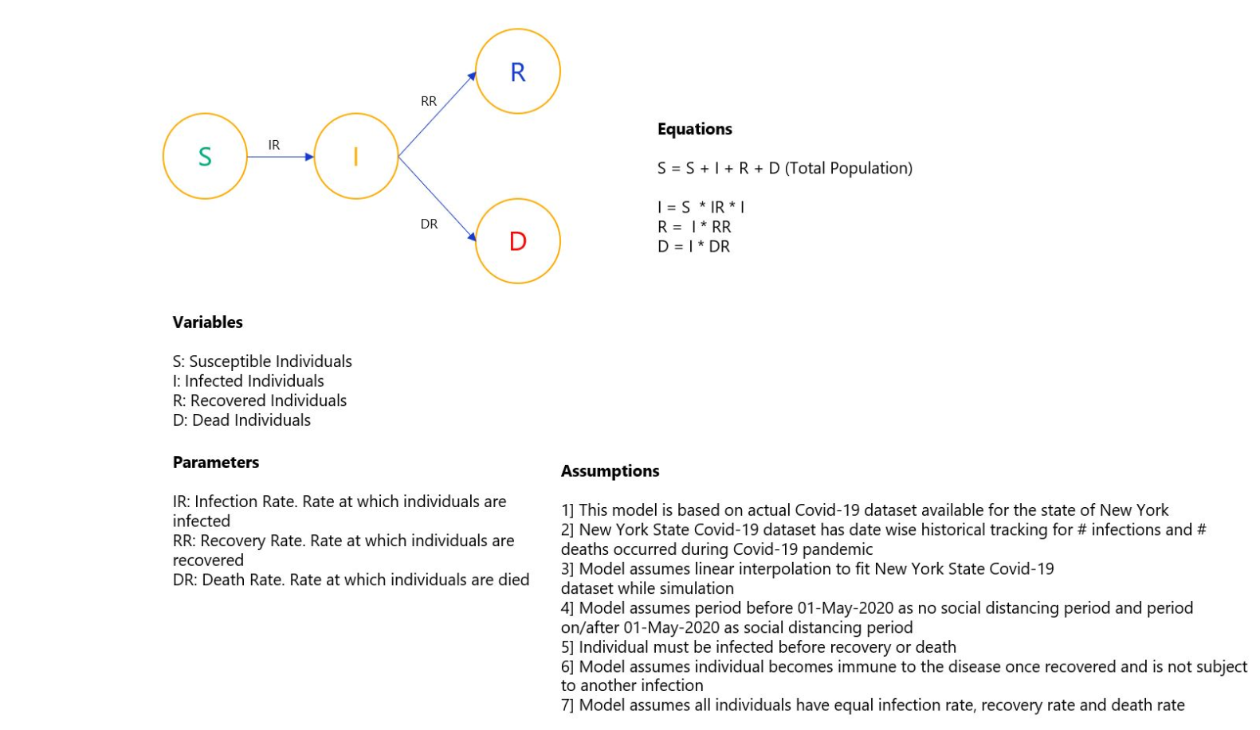
Provide a flow-chart model.

Slide 4
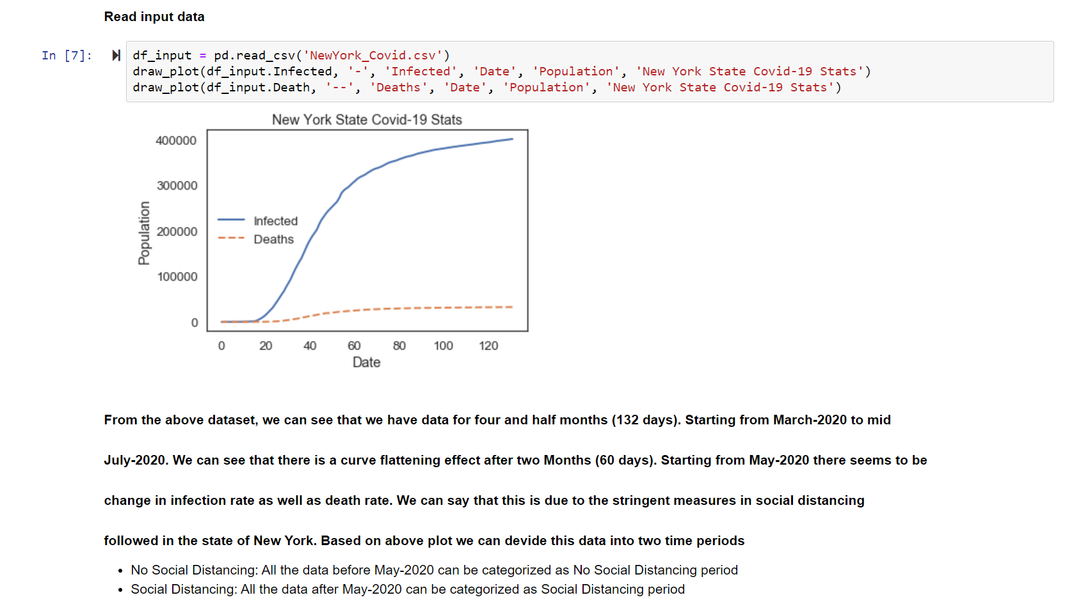
Load Data

Slide 5
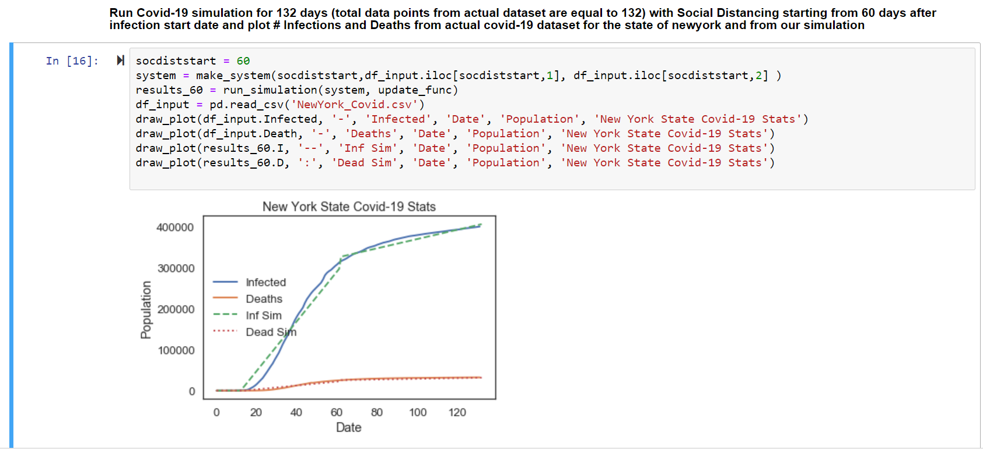
Model Fitting

Slide 6
Justify the validity of the model and discuss how you verified it.
Model Verification
Model assumes linear interpolation for fitting actual Covid-19 data observed for the state of New York while coming up with simulation From the graph above we can see that simulated curve nicely fits the actual curve. We can see that actual curve is not purely linear however linear interpolation seems to be doing a pretty good job while fitting the actual curve with some exception
Model also uses linear functions for simulation
I = Constant + (time * IR) Where IR = Infection Rate
D = Constant + (I * DR) Where DR = Death Rate
Note: IR and DR varies between period where no social distancing is followed and for period where social distancing was followed

Slide 7
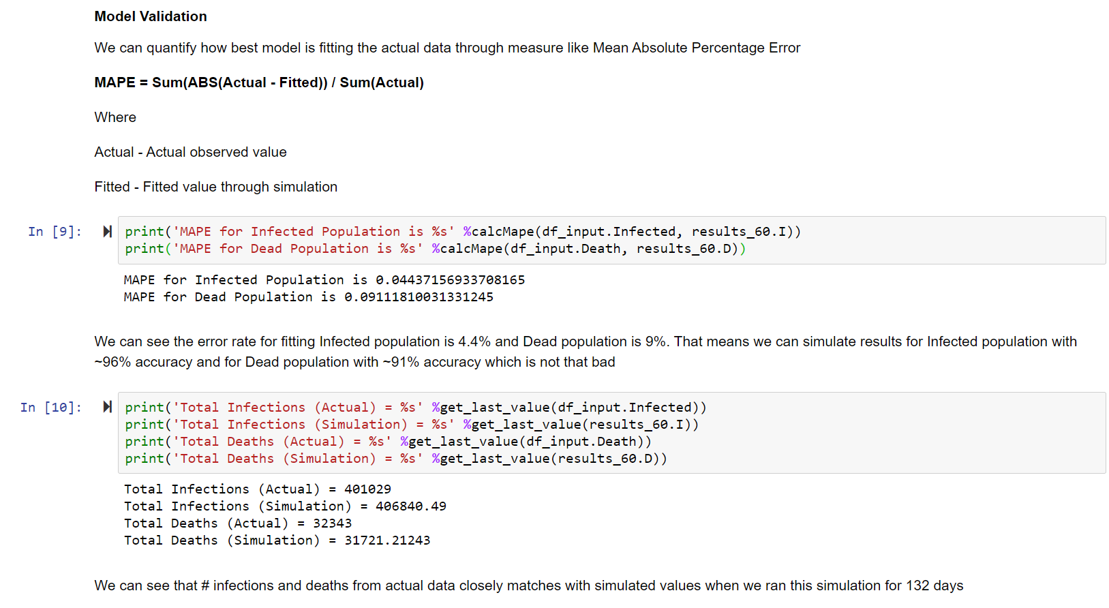
Model Validation

Slide 8
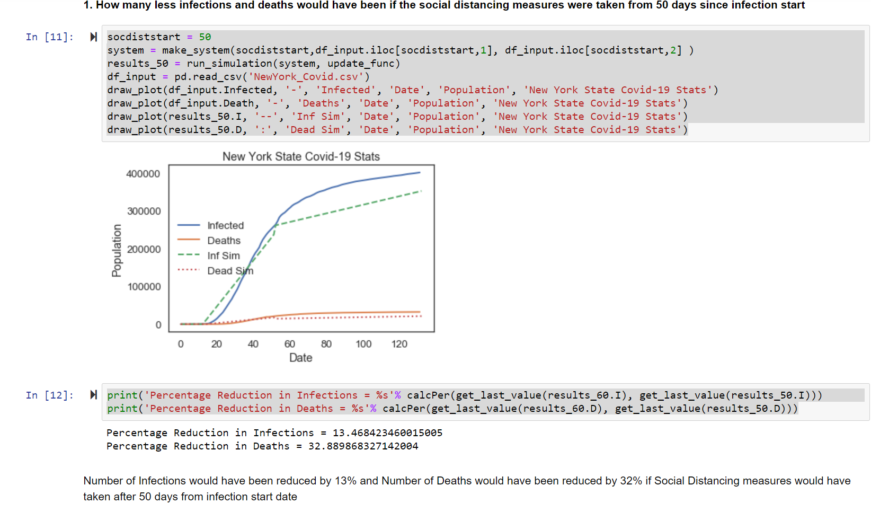
Finding-1

Slide 9
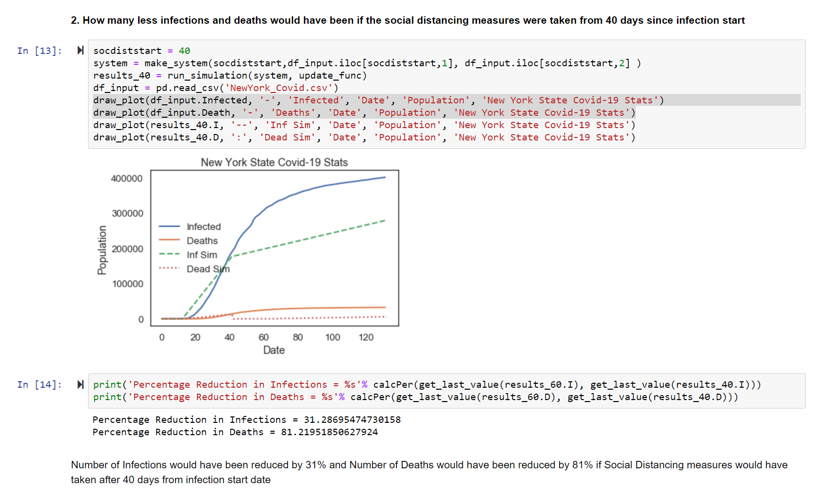
Finding-2

Slide 10
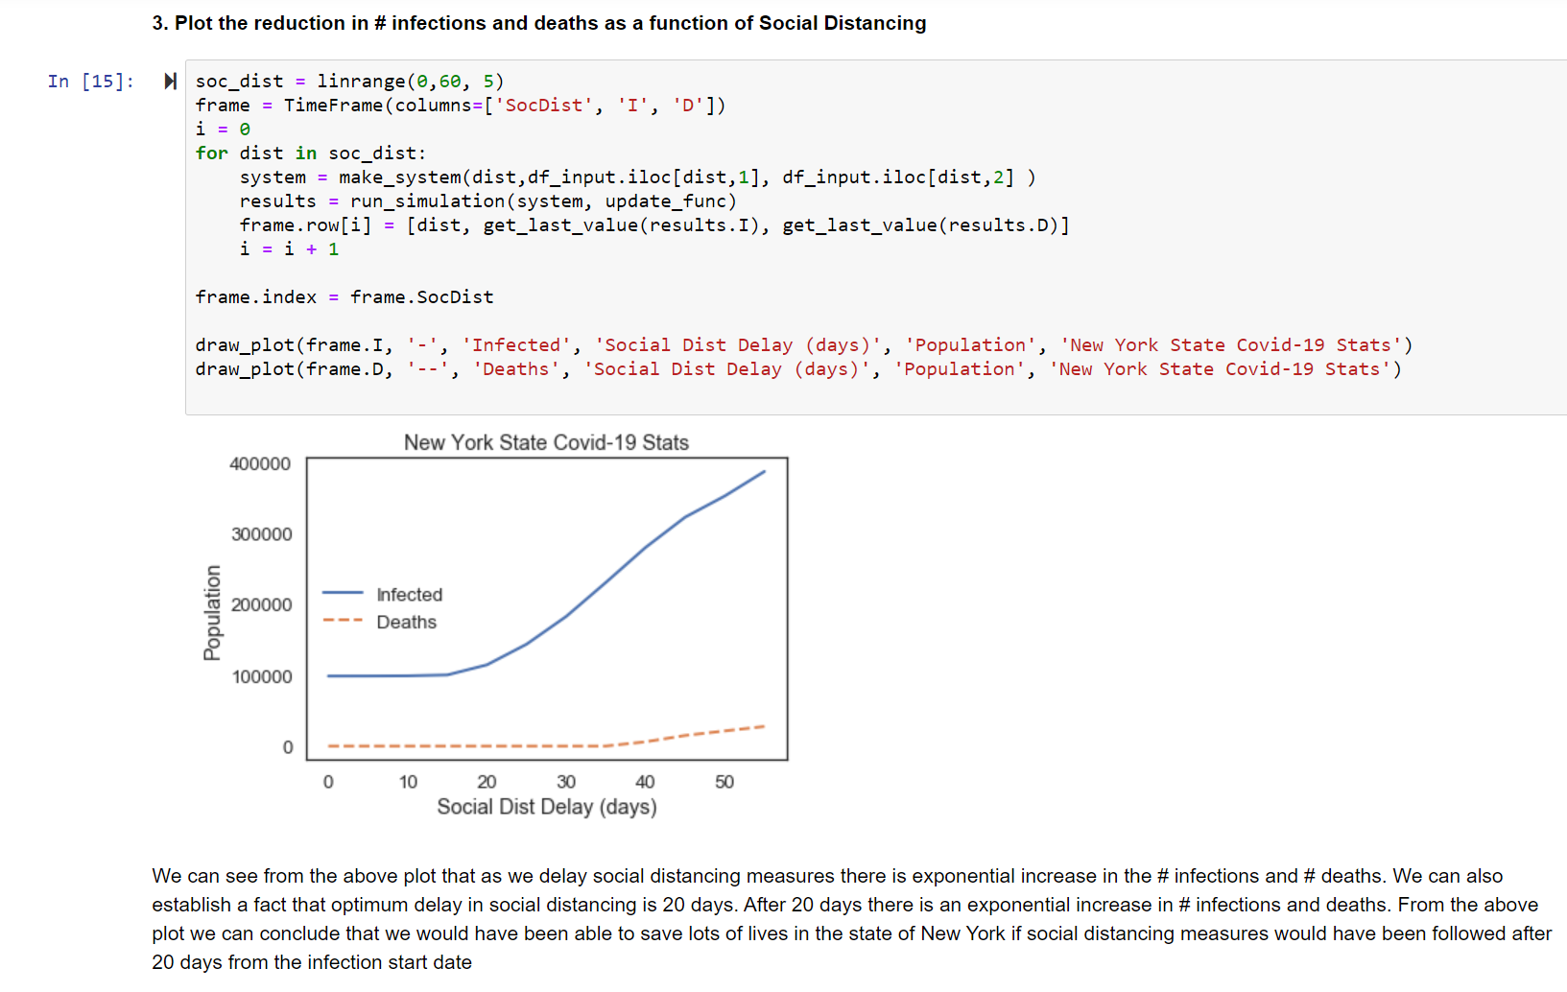
Finding-3

